Slide 2

Angular Directive & Pipes

Slide 3
Agenda
Directives
Component Directives
Structural Directives
Attribute Directives
Create a Custom Directives
Pipes
Built-in Pipes
Pure and Impure Pipes
Create a Custom Pipes

Slide 4
Angular – Directives
Directives are instructions in the DOM (Document Object Model). It specifies how to place our business logic in Angular. The directive is markers on a DOM element that tell Angular to attach a specified behavior to that DOM element or even transform the DOM element and its children. Mostly directives in Angular starts with ng- where ng stands for Angular, and it extends the HTML.
HTML
Angular
DOM Manipulation
Head
Body
Div
Image

Slide 5
Angular – Directives
There are three kinds of directives
Component Directives
Structural Directives
Attribute Directives

Slide 6
Angular – Component Directives
Components are the most common of the directives. It contains the details of how the component should be processed, instantiated, and used at runtime. The component comprises meta-data.

Slide 7
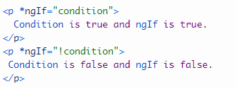
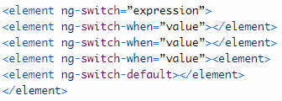
Angular – Structural Directive
Structural Directives are done in the elements section. These directives are used to manipulate and change the structure of the DOM elements. Structural directives have a star (*) sign before the directive. Like as,* ngIf, *ngFor, and *ngSwitch directive.
*ngIf Directive: The *ngIf allows us to Add/Remove DOM Element.
Syntax
*ngSwitch Directive: The *ngSwitch will enable us to Add/Remove DOM element. It is same as the switch statement of C#.
Syntax
*ngFor Directive: The *ngFor directive is used to repeat a part of HTML template once per each item from an iterable list (Collection).

Slide 8

Angular – Attribute Directive
It deals with changing the look and behavior of the DOM element. For example: ngStyle, ngClass etc.
NgStyle Directive: The ngStyle Directive facilitates you to modify the style of an HTML element using the expression. We can also use the ngStyle Directive to change the style of our HTML element dynamically.
Syntax:
Ex. ng-style=“{color:’red’}” will be translated to style="color:red“
NgClass Directive: The ngClass Directive is used to add or remove CSS classes to an element.
Syntax:
Ex. ng-class=“{‘deleted’:isDeleted}” will be translated to class="deleted" when isDeleted variable is true.

Slide 9
Angular – Directives
Structural Directive | Attribute Directive
It changes the structure of the DOM. * is prefixed to the structural directives. *ngIf, *ngFor are the examples of structural directives. | It just changes the appearance of the DOM. It is not prefixed with *. ngClass, ngStyle are the examples of attribute directives.

Slide 10


Angular – Create Custom Directive
We can create our custom directives to use in Angular components with the help of the command line. The command which is used to develop the Directive using the command line is as follows-
It is seen in the command line as given in the below code-
The above files, i.e., change-text directive.spec.ts and change-text.directive.ts created and the app.module.ts is updated.

Slide 11
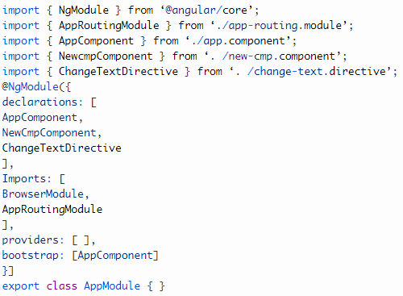
Angular – Create Custom Directive
app.module.ts
import { BrowserModule } from ‘@angular/platform-browser’;
The ChangeTextDirective class has been included in the declarations in the above file.

Slide 12
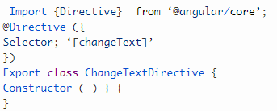
Angular – Create Custom Directive
The class is also imported from the file given below-
Change-text.directive
The above file has a directive and it also has a selector property. Whatever we define in the selector, the same has to match in the view, where we assign the custom directive.

Slide 13
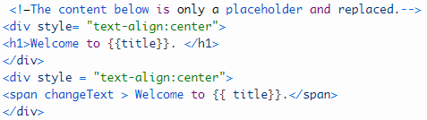
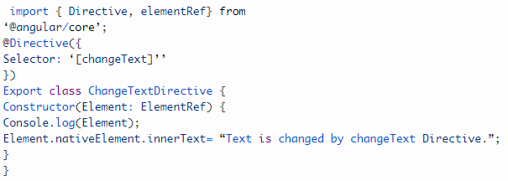
Angular – Create Custom Directive
In the app.component.html view, add the directive as follows-
We will write the changes in change-text.directive.ts file as-
change-text.directive.ts
In the above file, there is a class known as ChangeTextDirective, and also a constructor.

Slide 14
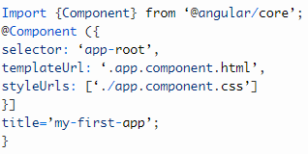
Angular – Pipes
Pipes are a useful feature in Angular. These are the simple way to transform values in an Angular template. It takes the integers, strings, array, and dates as input separated with | to be converted in the format as required and display same as an in the browser.
Syntax: {{title | uppercase}}
Example
Define a variable named “title” in the component.ts file.

Slide 15
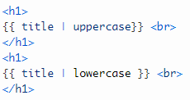
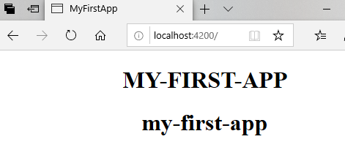
Angular – Pipes
Here, we are using the pipe symbol in component.html file:
Run ng serve and see the result. You will see the following result. We can see that pipes have changed the title in upper and lowercase.

Slide 16
Built-in Angular Pipes
Angular has a stock of pipes such as Date Pipe, Uppercase Pipe, Lowercase Pipe, currency pipe, and percent pipe. They are available for use in any angular template.
Angular doesn’t have the Filter Pipe or any Orderbypipe.
Angular doesn’t provide the pipes for filtering and sorting the lists.
Pipes are an excellent way to encapsulate and share a collective display-value transformation.
Async pipe
Currency pipe
Data pipe
Decimal pipe
Json pipe
Percent pipe
Lower case pipe
Upper case pipe
Slice pipe
Title case pipe

Slide 17


Angular – Parameterizing a Pipe
We can also move a parameter to the pipe; we can use the HTML code to pass the parameter.
app.component.html
Chaining pipes
We can chain pipes together and creates useful combinations and also can use the lowercase and upper-case pipe in our example.
app.component.html
Now, our date is in upper case letter.

Slide 18
Angular – Pure and Impure pipes
There are two categories of pipes:
Pure
Impure
By default, pipes of angular are pure. Every pipe we have seen are pure and built-in pipes. We can make the pipe impure by setting the pure flag into false.
Pure pipes
Angular executes the pure pipe only when if it detects the pure change in the input value. The real difference is either in the shift to the primitive input value (Number, Boolean, Symbol, String) or a changed object reference (Array, Function, Object, Date).
Impure pipes
Angular executes the impure pipe during every component change detection cycle. The impure pipe is called often every keystroke or mouse-move.

Slide 19
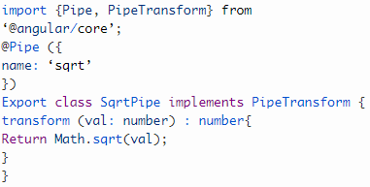
Angular – Create a Custom Angular Pipe
To create a custom pipe, we create a new ts file and use the code according to work, and we have to import Pipe, Pipe Transform from Angular/Core.
Create a sqrt custom pipe.
component.ts file:
We have to make changes in the app.module.ts. Create a class named as SqrtPipe.
This class will implement PipeTransform. The transform method defined in the class can take arguments as the number and will return the number after taking the square root.

Slide 20
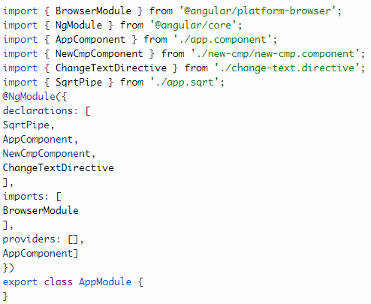
Angular – Create a Custom Angular Pipe
We have to add the same code in app.module.ts file
module.ts file:

Slide 21

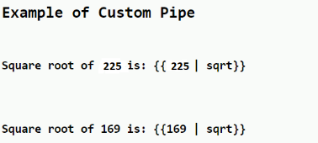
Angular – Create a Custom Angular Pipe
Now, use sqrt pipe in the component.html file.
component.html file:
Output:

Slide 22
THANK YOU

